Slide 1
Manipulation of DNA- 2
Restriction Enzymes

Slide 2
Restriction Enzymes
What are Restriction Endonucleases?
Nomenclature
Types
Recognition Sequences
Sticky and Blunt End Cutters
Isoschizomers and Neoschizomers
Activity- Unit Determination Assay
Factors affecting RE activity
Methylation
Temp., pH, cofactors etc.
Artificial Restriction Enzymes

Slide 3
What are Restriction Enzymes?
1962: “molecular scissors” discovered in in bacteria
E. coli bacteria have an enzymatic immune system that recognizes and destroys foreign DNA
3,000 enzymes have been identified, more than 300 are available for use in the lab, are purified and available commercially
Restriction enzymes are endonucleases (Endo (inside), nuclease(cuts nucleic acid), which catalyze the cleavage of the phosphodiester bonds within both strands of DNA.
They require Mg⁺² for activity and generate a 5 prime (5') phosphate and a 3 prime (3') hydroxyl group at the point of cleavage.
Nobel Prizes for W. Arber, H. Smith, and D. Nathans in 1978 as discovery of REs was one of the key breakthroughs in the development of genetic engineering.

Slide 4
Restriction Enzymes
The distinguishing feature of restriction enzymes is that they only cut at very specific sequences of bases. This specific DNA sequence is called recognition sequence.
Restriction enzymes are traditionally classified according to the subunit composition, cleavage position, sequence-specificity and cofactor requirements.
A restriction enzyme requires a specific double stranded recognition sequence of nucleotides to cut DNA.
Recognition sites are usually 4 to 8 base pairs in length.
Cleavage occurs within or near the site.

Slide 5
Nomenclature
Named for bacterial genus, species, strain, and type
Example: EcoR1
Genus: Escherichia Species: coli Strain: R Order discovered: 1

Slide 6
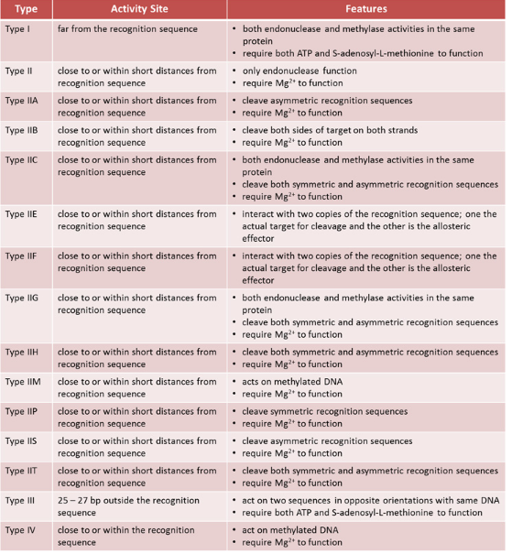

Slide 7
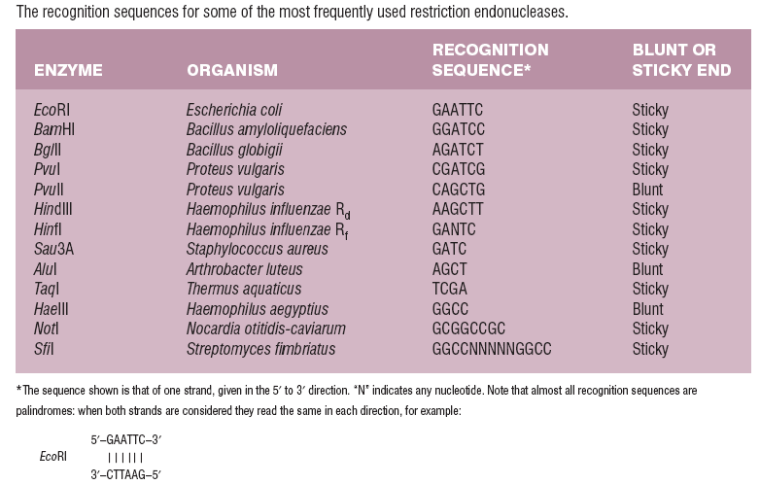
Palindromic Recognition Sites

Slide 8
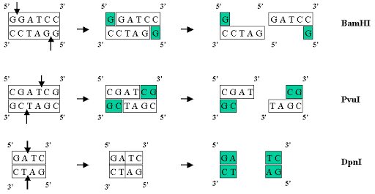
Sticky and Blunt end cutters
Some restriction endonucleases cut symmetrically and leave blunt ends. Many endonucleases cleave the DNA backbones in positions that are not directly opposite each other or can make staggered cuts, which produce single stranded “sticky-ends”.
5’ overhang
3’ overhang
Blunt ends

Slide 9
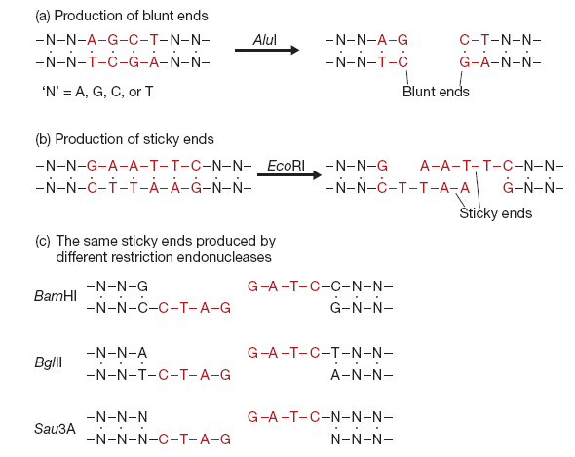
Isocaudomers

Slide 10
Isoschizomers and Neoschizomers
Isoschizomers are pairs of restriction enzymes specific to the same recognition sequence.
For example, SphI (CGTAC/G) and BbuI (CGTAC/G) are isoschizomers of each other. The first enzyme discovered which recognizes a given sequence is known as the prototype; all subsequently identified enzymes that recognize that sequence are isoschizomers.
Isoschizomers may require different reaction conditions.
An enzyme that recognizes the same sequence but cuts it differently is a neoschizomer. Neoschizomers are a specific type (subset) of isoschizomer.
For example,
SmaI (CCC/GGG) and XmaI (C/CCGGG) are neoschizomers of each other.
Similarly Kpn1 (GGTAC/C) and Acc651 (G/GTACC) are neoschizomers of each other.
3. The sequence GGCGCC is recognized by four enzymes, each of which cuts in different places: NarI (GG/CGCC), BbeI (GGCGC/C), EheI (GGC/GCC), and KasI (G/GCGCC).
Notes:
https://international.neb.com/tools-and-resources/selection-charts/isoschizomers

Slide 11
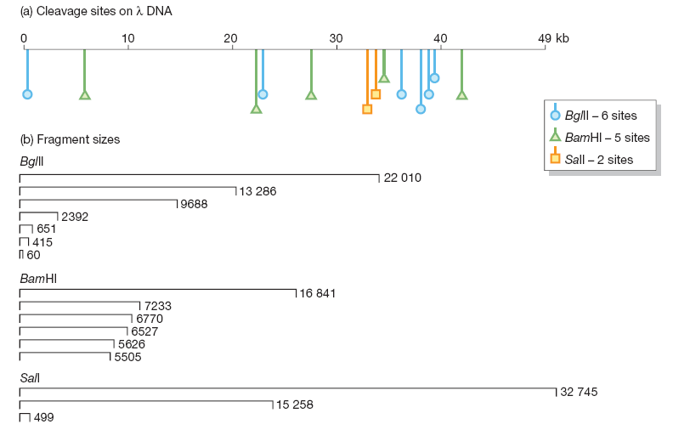
Frequency of Restriction Sites
A tetranucleotide sequence (e.g., GATC) should occur once every 4⁴ = 256 nucleotides, and a hexanucleotide (e.g., GGATCC) once every 4⁶ = 4096 nucleotides. These calculations assume that the nucleotides are ordered in a random fashion and that the four different nucleotides are present in equal proportions (i.e., the GC content = 50%). In practice, neither of these assumptions is entirely valid.

Slide 12
Unit Determination Assay
One unit of restriction endonuclease is defined as the amount of enzyme required to digest one microgram of the appropriate substrate DNA completely in 60 minutes in 50 ul reaction under the conditions specified for that enzyme.

Slide 13
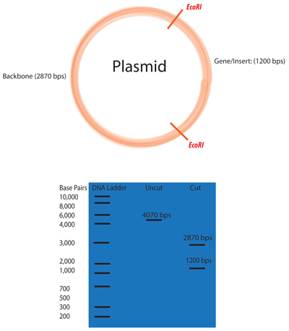
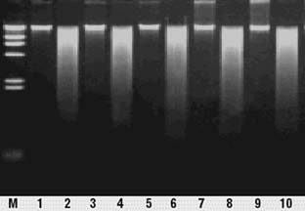
Set up of a restriction enzyme reaction
A RE reaction contains the DNA to be analyzed,
A restriction enzyme,
A restriction enzyme buffer mix.
contains a buffering agent to maintain constant pH,
and Mg⁺⁺ (from MgCl₂) as a necessary cofactor for enzyme activity.
Plant Genomic DNA
Odd numbered lanes contain undigested genomic DNA
Even numbered lanes contain digested genomic DNA

Slide 14
Factors that affect Restriction Enzyme Activity
The digestion activity of restriction enzymes depends on the following factors:
Temperature: Most endonucleases digest the target DNA at 37°C with few exceptions. Some work at lower temperatures (~25°C, Sma 1) while Taq I works at 65°C.
Cofactors: Restriction endonucleases require certain cofactors or combination of cofactors to digest at the recognition site. All enzymes require Mg²⁺ as a cofactor for the endonuclease activity. In R-M systems with separate proteins having the restriction and methylation activities, S-adenosylmethionine (SAM) and ATP are required for methylation activity.
Ionic Conditions: As mentioned previously, Mg²⁺ is required for all endonucleases but some enzymes also require ions such as Na⁺ and K⁺.
Buffer systems: Most restriction enzymes are active in the pH range of 7.0–8.0. Tris-HCl, is the most commonly used buffer.
Methylation status of DNA: Methylation of adenine or cytidine residues affects the digestion of DNA.
Notes:
DNA methylation occurs at the C-5 or N-4 positions of cytosine and at the N-6 position of adenine

Slide 15
Methylation of DNA Strands
Methylation of DNA is a major factor that affects the specificity of restriction endonucleases. DNA isolated from strains of bacteria expressing methylases such as Dam or Dcm may be resistant to cleavage by endonucleases as the recognition sites are methylated. Plasmid DNA isolated from E. coli expressing Dam is methylated at the GATC sites making it resistant to cleavage by Mbo I.
Use of Isoschizomers to determine the methylation status
In some cases, only one out of a pair of isoschizomers can recognize both the methylated as well as unmethylated forms of restriction sites. In contrast, the other restriction enzyme can recognize only the unmethylated form of the restriction site. This property of some isoschizomers allows identification of methylation state of the restriction site.
For example, the restriction enzymes HpaII and MspI are isoschizomers, as they both recognize the sequence 5'-CCGG-3' when it is unmethylated. But when the second C of the sequence is methylated, only MspI can recognize it while HpaII cannot.
Notes:
https://international.neb.com/tools-and-resources/selection-charts/dam-dcm-and-cpg-methylation
Common lab E. coli K12 strains such as DH5alpha contain 3 methylases that recognize and methylate different stretches of DNA:
Dam methylase adds a methyl group to the adenine of GATC stretches of DNA
Dcm methylase adds a methyl group to the second cytosine of CCWGG
EcoKI methylase adds a methyl group to the adenine in AACNNNNNNGTGC or GCACNNNNNNGTT
https://blog.addgene.org/plasmids-101-methylation-and-restriction-enzymes

Slide 16
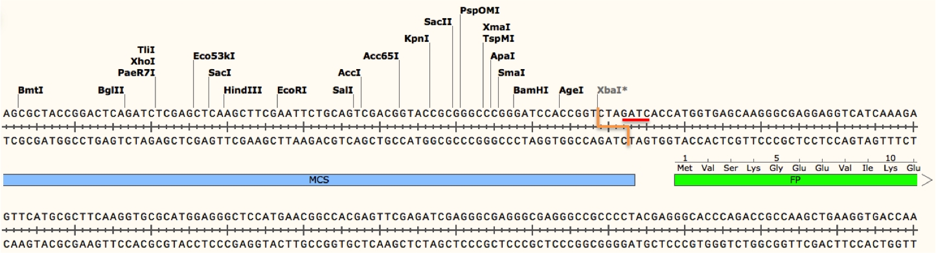
Methylation of DNA Strands
For example, cleavage by XbaI may be blocked due to methylation if the XbaI's recognition site (TCTAGA) is preceded by GA or followed by TC. As shown in the figure below, a Dam methylase recognition site (underlined in red- GATC) overlaps with the XbaI cut site (depicted as an orange line) because the restriction site is followed by TC. Addition of the methyl group at this site would block the enzyme from cutting the DNA there, although other restriction sites (including other XbaI sites not preceded by GA or followed by TC) would be cut as normal. If not taken into account, this blocked site could potentially give you results that would either be difficult to interpret or lead you to conclude your plasmid is not correct!
Conversely, enzymes such as DpnI require methylation at their recognition sites in order to efficiently cleave DNA. DpnI is often used for site directed mutagenesis. During this process, incorporation of a desired mutation into your plasmid of interest by PCR generates mutated plasmids with no methylation (there are no methyltransferases in the PCR reaction). The template plasmid, on the other hand, should be derived from a dam+ E. coli strain and will therefore have methylated adenines in any GATC sequences found in the plasmid. When the PCR products are digested with DpnI, only the non-mutated and methylated template is destroyed leaving behind a pool of mutated plasmids which can later be verified by Sanger sequencing.
Refer- https://blog.addgene.org/plasmids-101-methylation-and-restriction-enzymes
Notes:
https://international.neb.com/tools-and-resources/selection-charts/dam-dcm-and-cpg-methylation
Common lab E. coli K12 strains such as DH5alpha contain 3 methylases that recognize and methylate different stretches of DNA:
Dam methylase adds a methyl group to the adenine of GATC stretches of DNA
Dcm methylase adds a methyl group to the second cytosine of CCWGG
EcoKI methylase adds a methyl group to the adenine in AACNNNNNNGTGC or GCACNNNNNNGTT
https://blog.addgene.org/plasmids-101-methylation-and-restriction-enzymes

Slide 17

Considerations while designing primers with Restriction enzyme sites
oligo % cleavage
sequence 2h 20h
BamHI CGGATCCG 10 25
CGGGATCCCG >90 >90
CGCGGATCCGCG >90 >90
EcoRI GGAATTCC >90 >90
CGGAATTCCG >90 >90
CCGGAATTCCGG >90 >90
HindIII CAAGCTTG 0 0
CCAAGCTTGG 0 0
CCCAAGCTTGGG 10 75
NcoI CCCATGGG 0 0
CATGCCATGGCATG 50 75
NdeI GGGTTTCATATGAAACCC 0 0
GGAATTCCATATGGAATTCC 75 >90

Slide 18
Star Activity of Restriction Enzymes
Star activity is defined as the alteration in the digestion specificity that occurs under sub-optimal enzyme conditions. Star activity results in cleavage of DNA at non-specific sites. Some of the sub-optimal conditions that result in star activity are as follows:
pH >8.0
glycerol concentration of >5%
enzyme concentration >100 units/mg of DNA
increased incubation time with the enzyme
presence of organic solvents in the reaction mixture
Incorrect cofactor or buffer

